Slide 1
Chapter 25 - Beyond C & C++: Operators, Methods, and Arrays in Java
Outline
25.1 Introduction
25.2 Primitive Data Types and Keywords
25.3 Logical Operators
25.4 Method Definitions
25.5 Java API Packages
25.6 Random Number Generation
25.7 Example: A Game of Chance
25.8 Methods of Class JApplet
25.9 Defining and Allocating Arrays
25.10 Examples Using Arrays
25.11 References and Reference Parameters
25.12 Multiple-Subscripted Arrays

Slide 2
Objectives
In this chapter, you will learn:
  To understand primitive types and logical operators as they are used in Java.
  To introduce the common math methods available in the Java API.
  To be able to create new methods.
  To understand the mechanisms used to pass information between methods.
  To introduce simulation techniques using random number generation.
  To understand array objects in Java.
  To understand how to write and use methods that call themselves.

Slide 3
25.1 Introduction
In this chapter
  Differences between C, C++, and Java
  Java's logical operators and methods
  Packages that comprise Applications Programming Interface (API)
  Craps simulator
  Random numbers in Java
  Arrays in Java

Slide 4
25.2 Primitive Data Types and Keywords
Primitive data types
  char, byte, short, int, long, float, double, boolean
  Building blocks for more complicated types
    All variables must have a type before being used
    Strongly typed language
  Primitive types portable, unlike C and C++
    In C/C++, write different versions of programs
      Data types not guaranteed to be identical
      ints may be 2 or 4 bytes, depending on system
    WORA - Write once, run anywhere
  Default values
    boolean gets false, all other types are 0

Slide 5
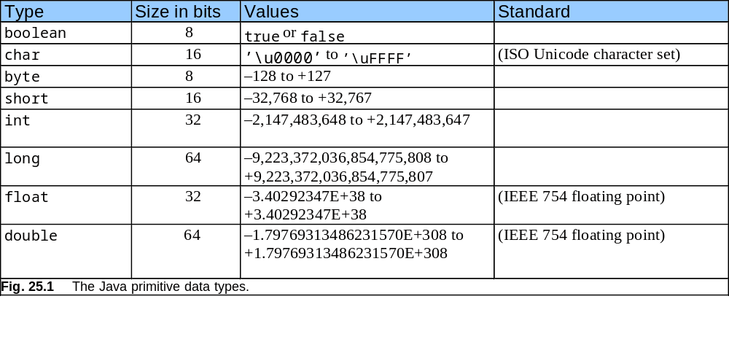
25.2 Primitive Data Types and Keywords (II)

Slide 6
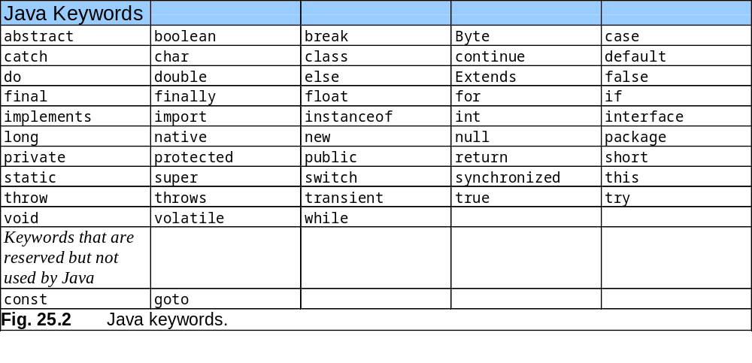
25.2 Primitive Data Types and Keywords (III)
Keywords
  Reserved names, cannot be used as identifiers
  Used to implement features

Slide 7
25.3 Logical Operators
Logical operators
  Form complex conditions and control structures
  Logical AND (&&)
    true if both conditions true
  Logical OR (||)
    true if either condition true
    true if both conditions true (inclusive)
    If left condition true, skips right condition
  Boolean logical AND (&) , boolean logical inclusive OR (|)
    Act like counterparts, but always evaluate both expressions
    Useful if expression performs action:
    birthday == true | ++age >= 65

Slide 8
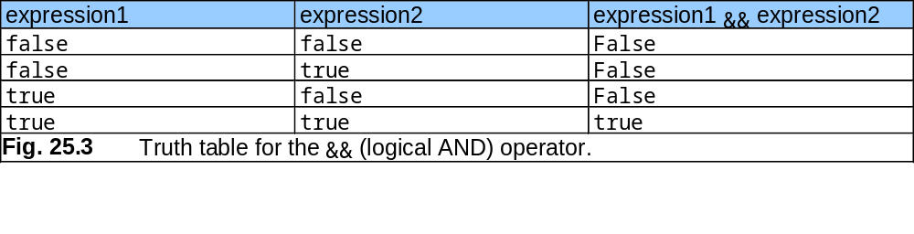
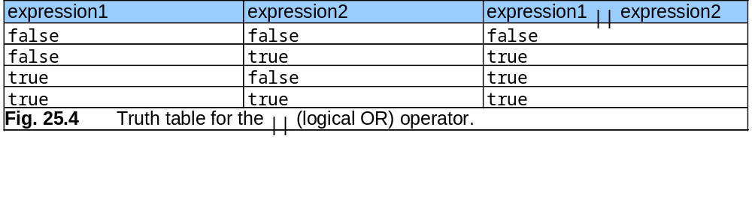
25.3 Logical Operators (II)

Slide 9
25.3 Logical Operators (III)
Logical Operators (continued)
  Boolean logical exclusive OR (^)
    true if exactly one condition true
    false if both conditions true
  Logical NOT (negation)
    Unary operator (one operand)
      All other logical operators binary (two operands)
    Reverses condition
    If true, returns false
    If false, returns true
    != - "does not equal"
    if (grade != sentinelValue)

Slide 10
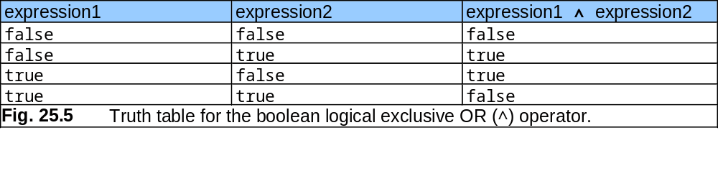
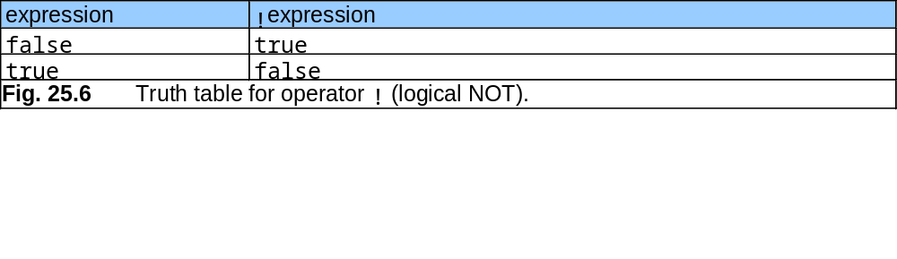
25.3 Logical Operators (IV)

Slide 11
25.3 Logical Operators (V)
More GUI Classes (javax.swing)
  JTextArea
    Create an area where text can be displayed
    Provide (rows, columns) to constructor to specify size
    JTextArea myArea; //declares object type
    myArea = new JTextArea( 17, 20 ); //initialize
  myArea.setText( myString );
    Sets the text of myArea to myString
  JScrollPane
    Creates a window that can scroll
    JScrollPane myScroller =
    new JScrollPane ( myArea );
    Declaration and initialization, allows myArea to have scrolling

Slide 12
25.3 Logical Operators (VI)
More GUI classes
  showMessageDialog(null, myScroller, titleString, type);
    Second argument indicates that myScroller (and attached myArea) should be displayed in message dialog

Slide 13
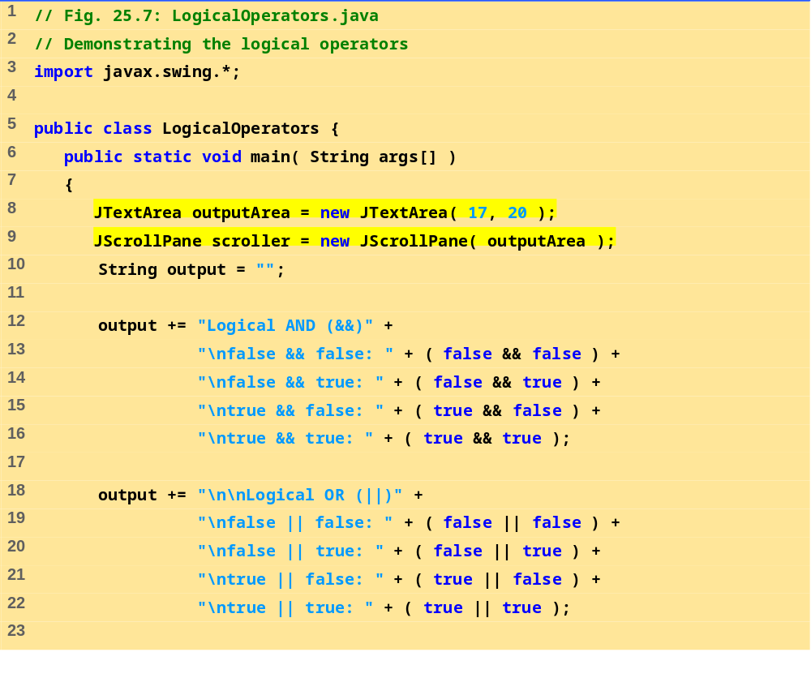
Logical-Operators.java (Part 1 of 2)

Slide 14
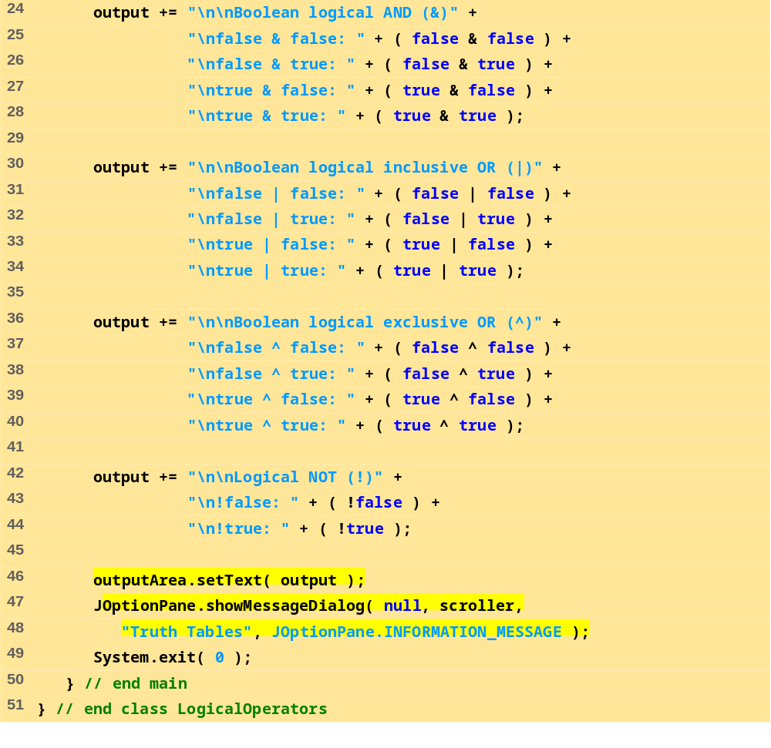
Logical-Operators.java (Part 2 of 2)

Slide 15
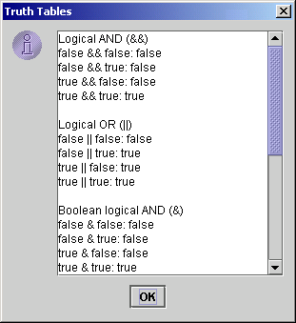
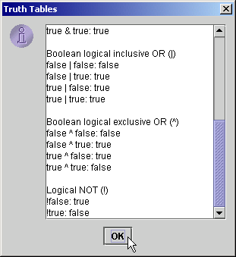
Program Output

Slide 16
25.4 Method Definitions
Method definition format
  return-value-type method-name( parameter-list )
  {
  declarations and statements
  }
  Method-name: any valid identifier
  Return-value-type: data type of the result
    void - method returns nothing
    Can return at most one value
  Parameter-list: comma separated list, defines parameters
    Method call must have proper number and type of parameters
  Definitions and statements: method body (block)
    Variables can be defined inside blocks (can be nested)
    Method cannot be defined inside another function

Slide 17
25.4 Method Definitions (II)
Program control
  When method call encountered
    Control transferred from point of invocation to method
  Returning control
    If nothing returned: return;
      Or until reaches right brace
    If value returned: return expression;
      Returns the value of expression
  Example user-defined method:
  public int square( int y )
  {
  return y * y
  }

Slide 18
25.4 Method Definitions (III)
Calling methods
  Three ways
    Method name and arguments
      Can be used by methods of same class
      square( 2 );
    Dot operator - used with objects
      g.drawLine( x1, y1, x2, y2 );
    Dot operator - used with static methods of classes
      Integer.parseInt( myString );
      More Chapter 26

Slide 19
25.4 Method Definitions (IV)
More GUI components
  Content Pane - on-screen display area
    Attach GUI components to it to be displayed
    Object of class Container (java.awt)
  getContentPane
    Method inherited from JApplet
    Returns reference to Content Pane
    Container c = getContentPane();
  Container method add
    Attaches GUI components to content pane, so they can be displayed
    For now, only attach one component (occupies entire area)
    Later, learn how to add and layout multiple components
    c.add( myTextArea );

Slide 20
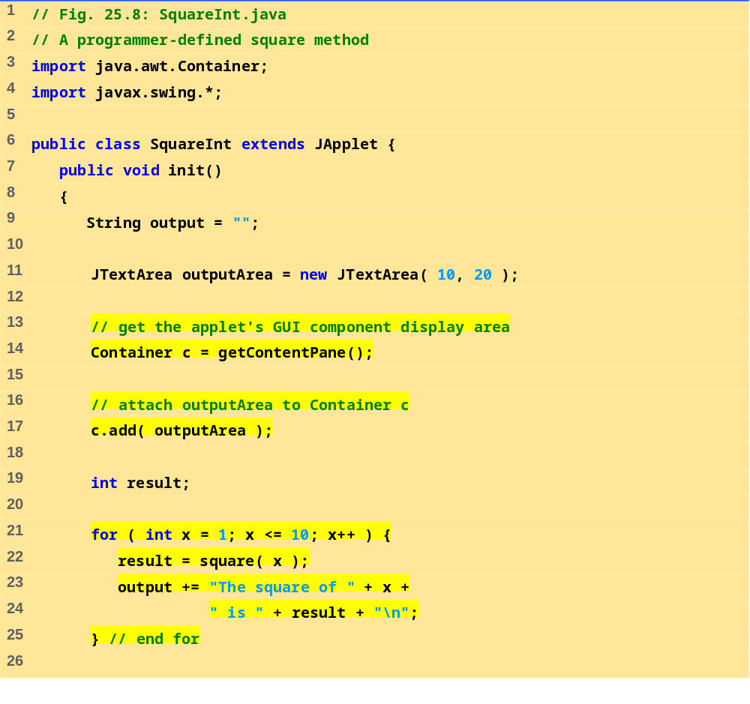
SquareInt.java (Part 1 of 2)

Slide 21
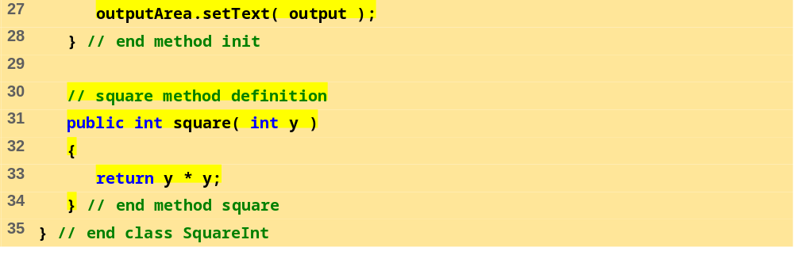
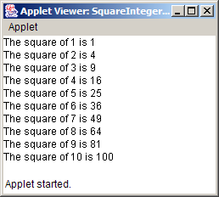
SquareInt.java (Part 2 of 2)
Program Output

Slide 22
25.5 Java API Packages
As we have seen
  Java has predefined, grouped classes called packages
  Together, all the packages are the Applications Programming Interface (API)
  Fig 25.10 has a list of the packages in the API
Import
  Import statements specify location of classes
  Large number of classes, avoid reinventing the wheel

Slide 23
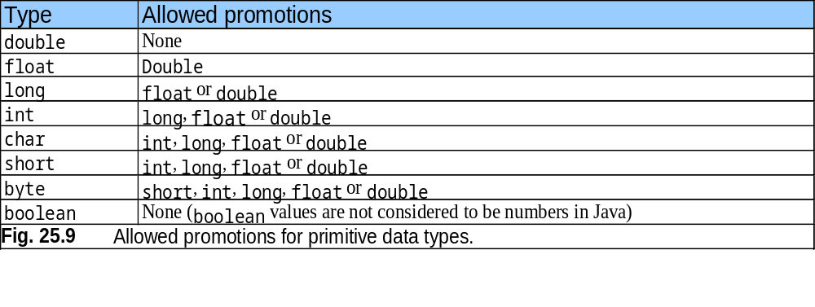
25.5 Java API Packages (II)

Slide 24
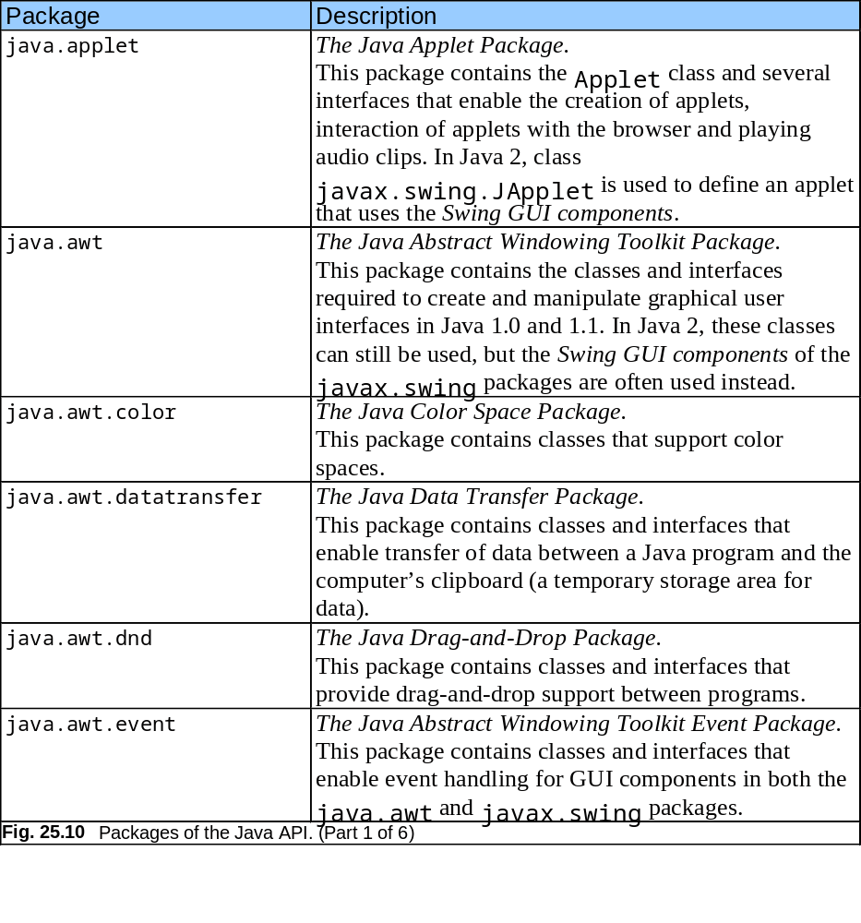
25.5 Java API Packages (III)

Slide 25
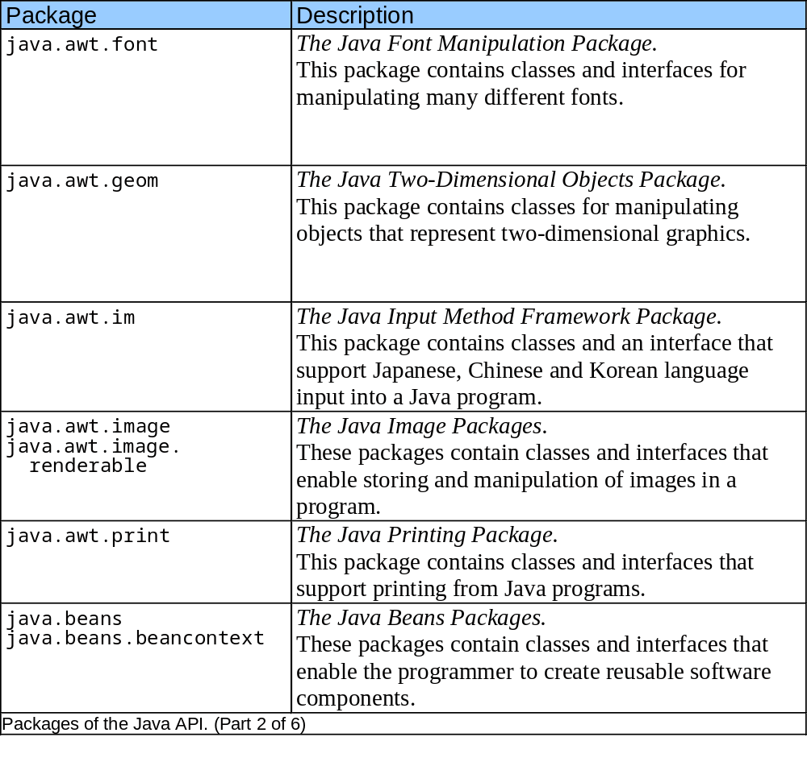
25.5 Java API Packages (IV)

Slide 26
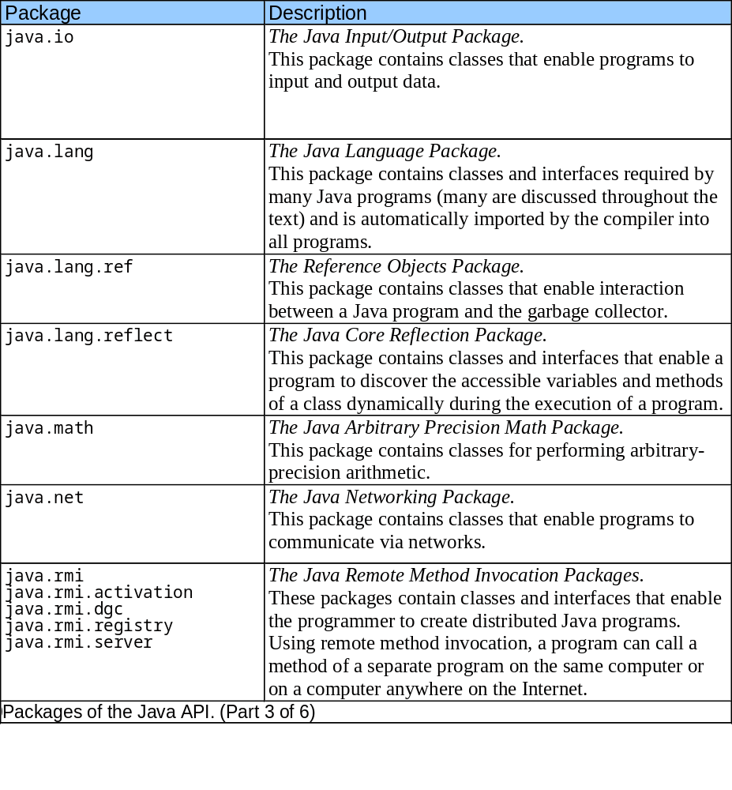
25.5 Java API Packages (V)

Slide 27
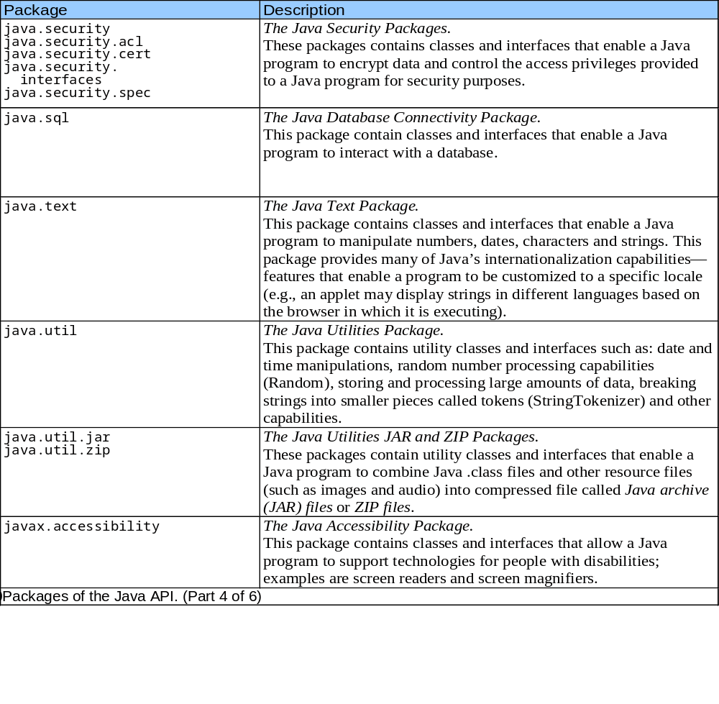
25.5 Java API Packages (VI)

Slide 28
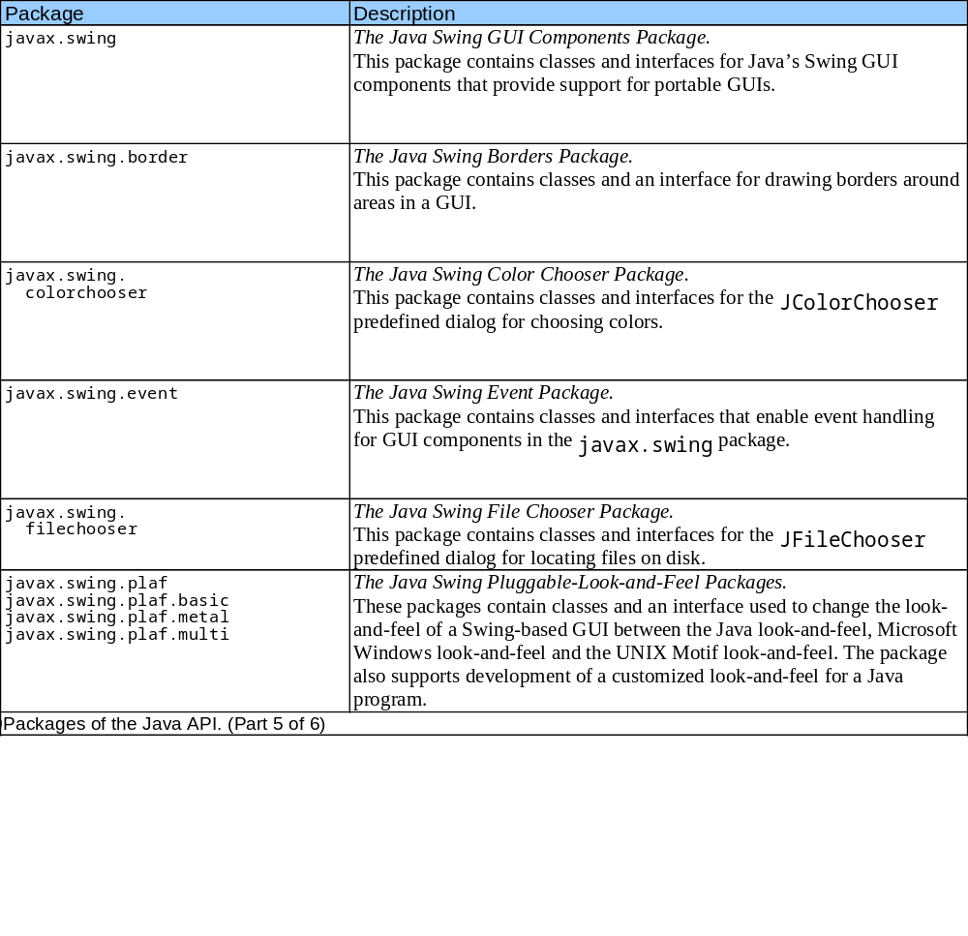
25.5 Java API Packages (VII)

Slide 29
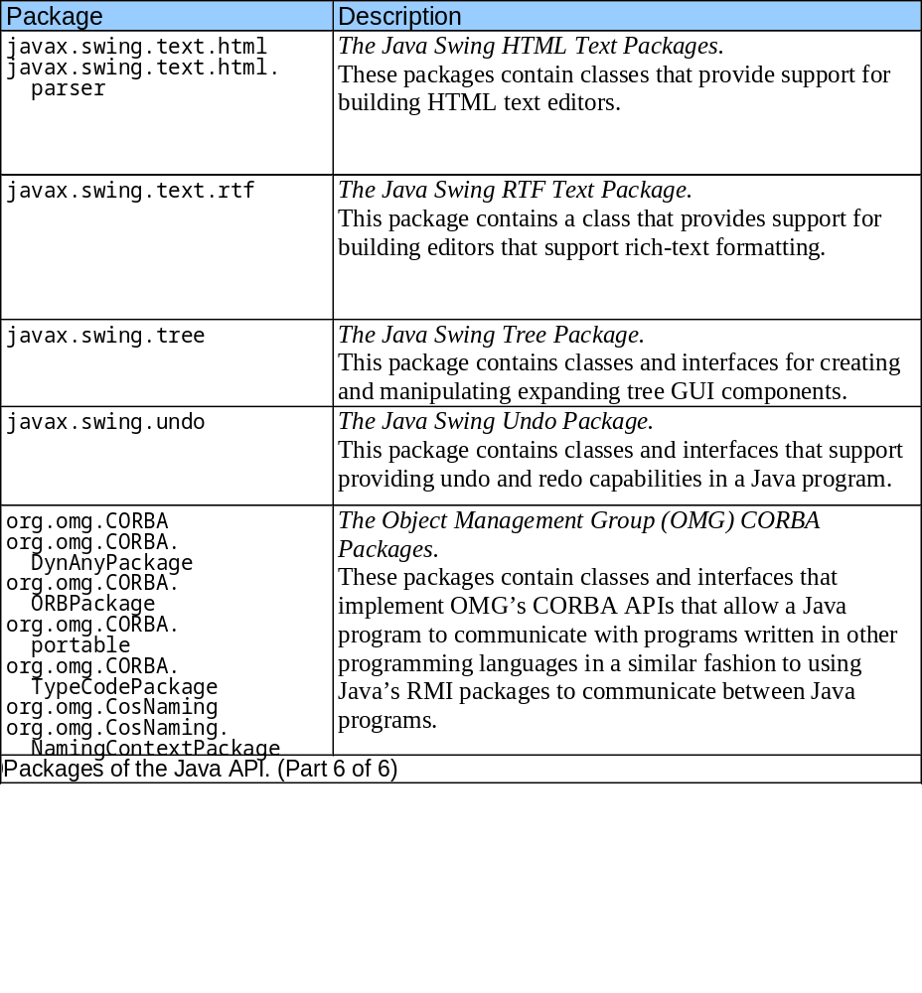
25.5 Java API Packages (VIII)

Slide 30
25.6 Random Number Generation
Math.random()
  Returns a random double,greater than or equal to 0.0, less than 1.0
Scaling and shifting
  n = a + (int) ( Math.random() * b )
  n = random number
  a = shifting value
  b = scaling value
  In C we used %, but in Java we can use *
  For a random number between 1 and 6,
  n = 1 + (int) ( Math.random() * 6 )

Slide 31
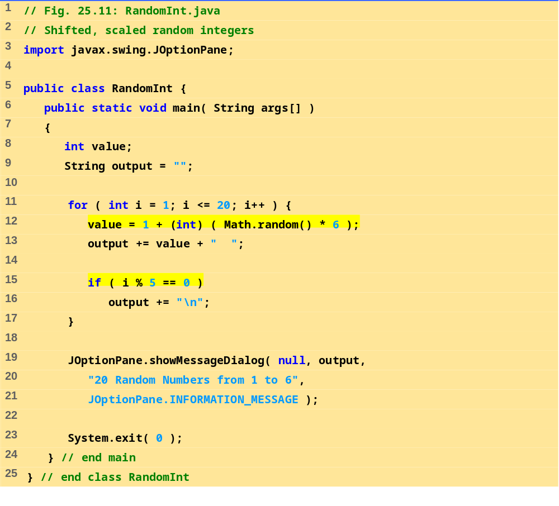
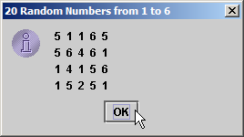
RandomInt.java
Program Output

Slide 32
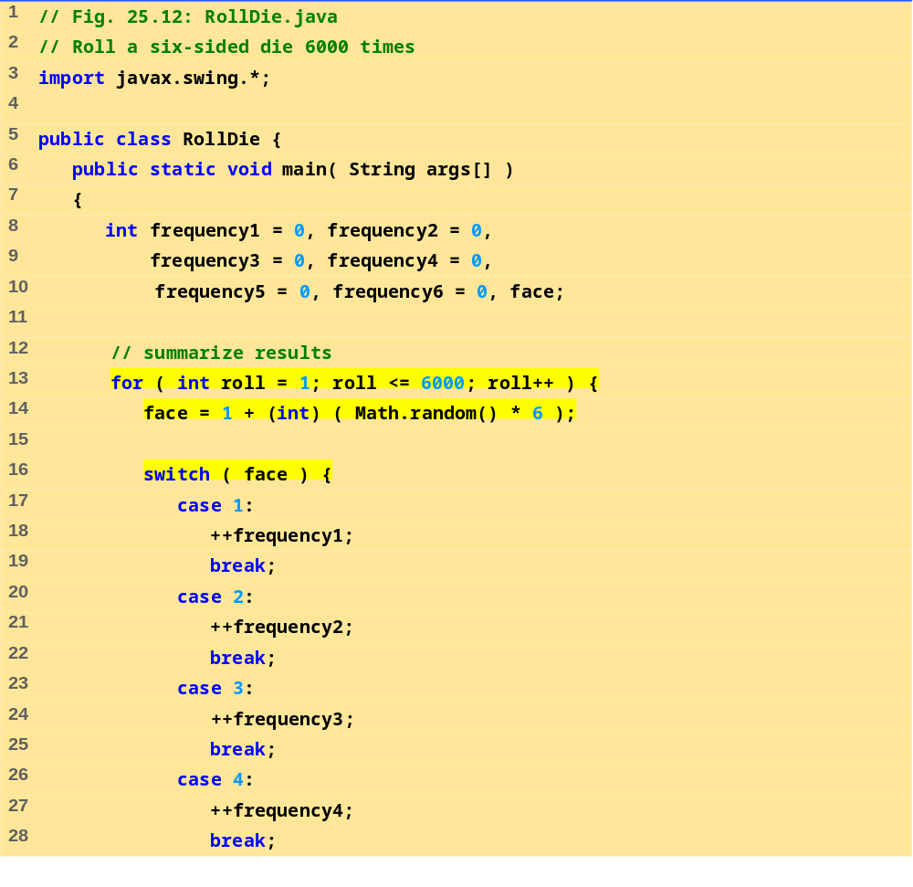
RollDie.java (Part 1 of 2)

Slide 33
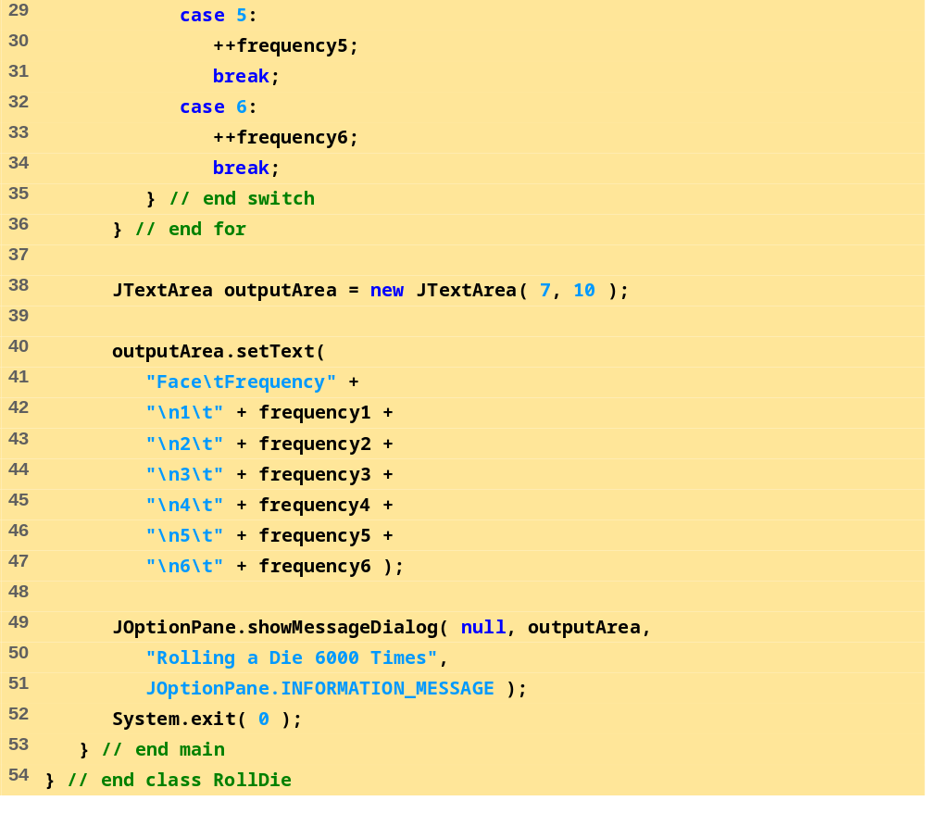
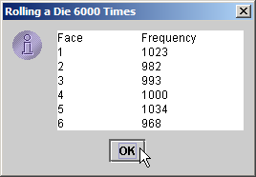
RollDie.java (Part 1 of 2)
Program Output

Slide 34
25.7 Example: A Game of Chance
Redo "craps" simulator from Chapter 5
Rules
  Roll two dice
    7 or 11 on first throw, player wins
    2, 3, or 12 on first throw, player loses
    4, 5, 6, 8, 9, 10 - value becomes player's "point"
  player must roll his point before rolling 7 to win

Slide 35
25.7 Example: A Game of Chance (II)
User input
  Till now, used message dialog and input dialog
    Tedious, only show one message/ get one input at a time
  Now, we will use event handling for more complex GUI
extends keyword
  Class inherits data and methods from another class
  A class can also implement an interface
    Keyword implements
    Interface - specifies methods you must define in your class
Event handling
  Event: user interaction (i.e., user clicking a button)
  Event handler: method called in response to an event

Slide 36
25.7 Example: A Game of Chance (III)
Interface ActionListener
  Requires that you define method actionPerformed
    actionPerformed is the event handler
Class JTextField
  Can display or input a line of text
Class JButton
  Displays a button which can perform an action if pushed
  Method addActionListener( this );
    Specifies this applet should listen for events from the JButton object
  Each component must know which method will handle its events
    Registering the event handler

Slide 37
25.7 Example: A Game of Chance (IV)
Class JButton (continued)
  We registered this applet with our JButton
    The applet "listens" for events from the
  actionPerformed is the event handler
Event-driven programming
  User's interaction with GUI drives program
final
  Defines a variable constant
    Cannot be modified
    Must be initialized at definition
    const int MYINT = 3;
    Use all uppercase for final variables

Slide 38
25.7 Example: A Game of Chance (V)
Methods of class Container
  Recall that the Content Pane is of class Container
  Method setLayout
    Define layout managers (determine position and size of all components attached to container)
    FlowLayout - Most basic layout manager
      Items placed left to right in order added to container
      When end of line reached, continues on next line
      c = getContentPane();
      c.setLayout( new FlowLayout() );
      Initialized with object of class FlowLayout

Slide 39
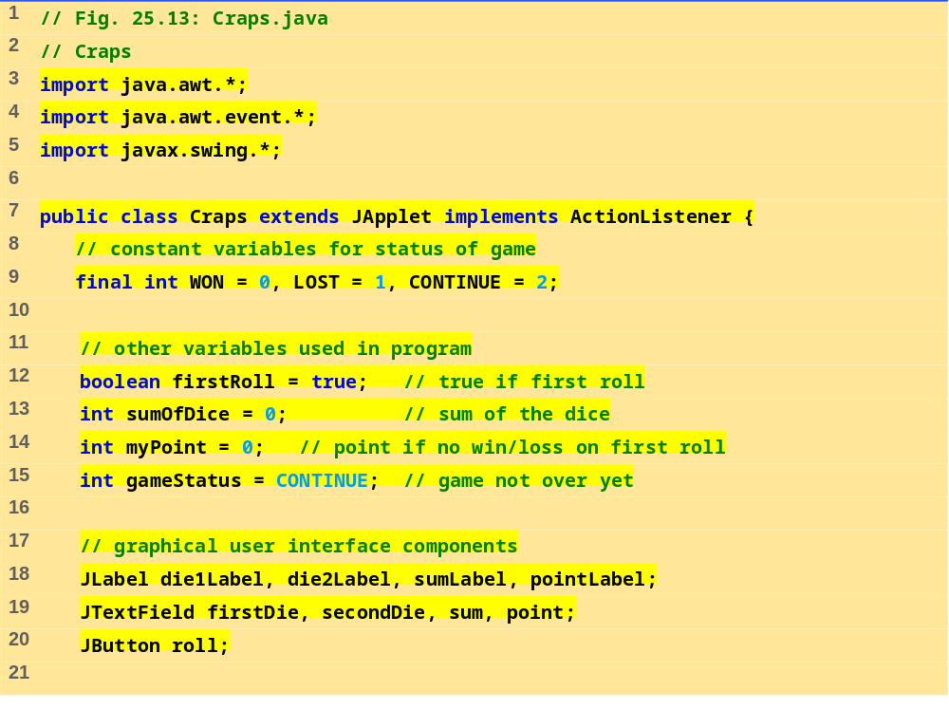
Craps.java (Pat 1 of 5)

Slide 40
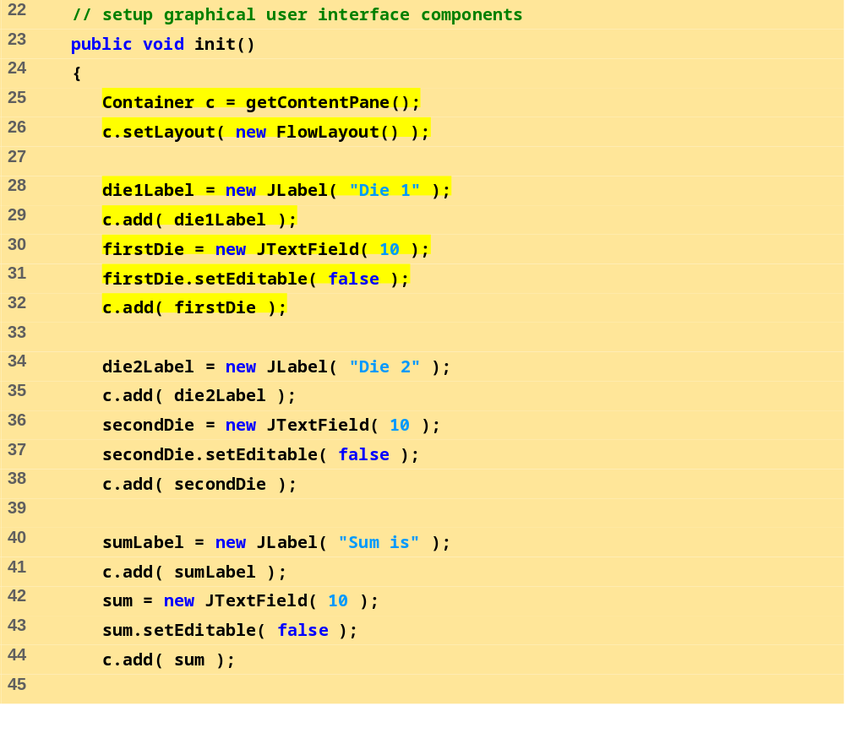
Craps.java (Pat 2 of 5)

Slide 41
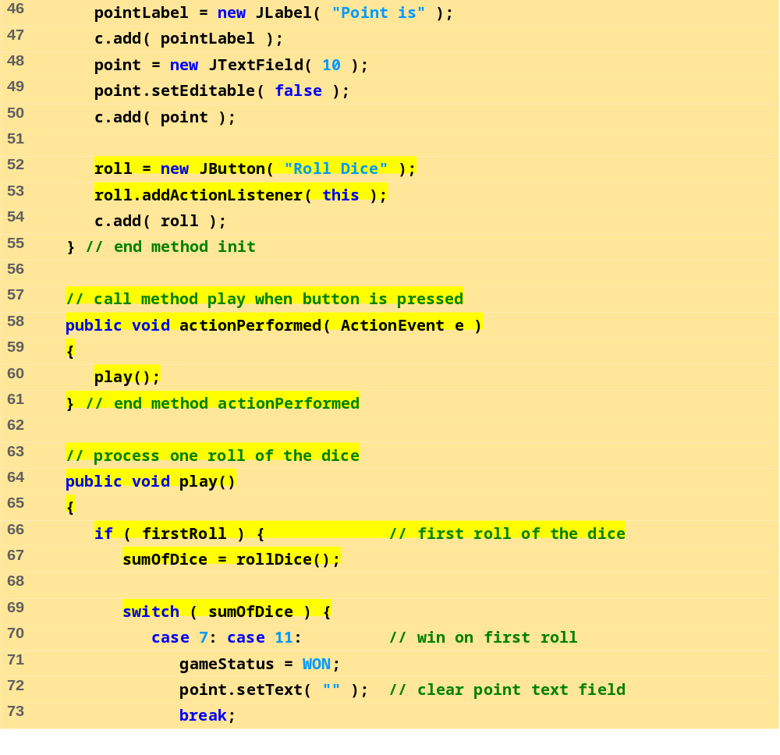
Craps.java (Pat 3 of 5)

Slide 42
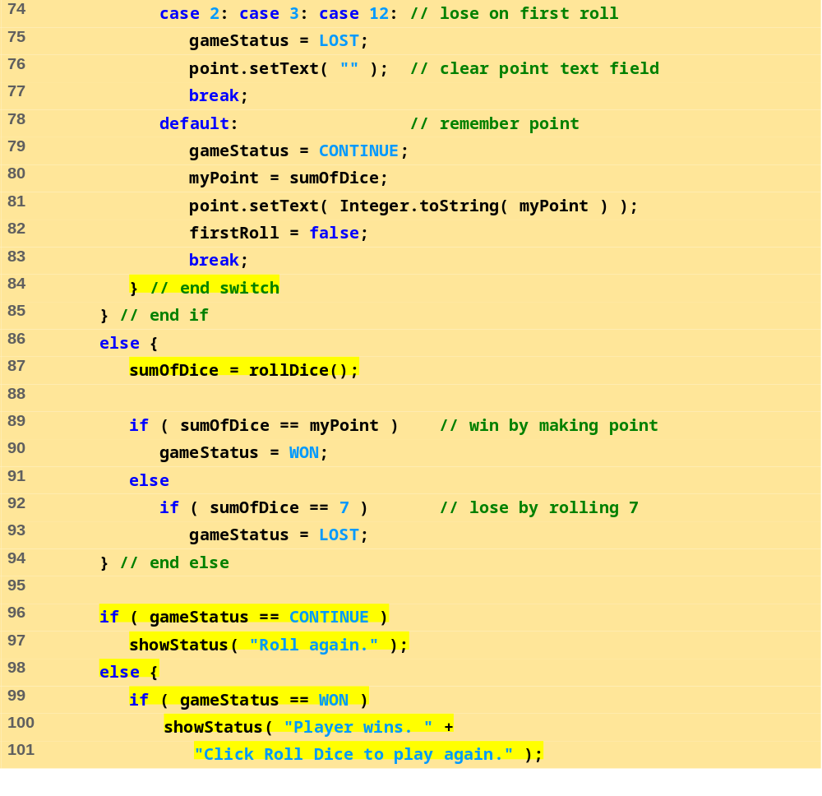
Craps.java (Pat 4 of 5)

Slide 43
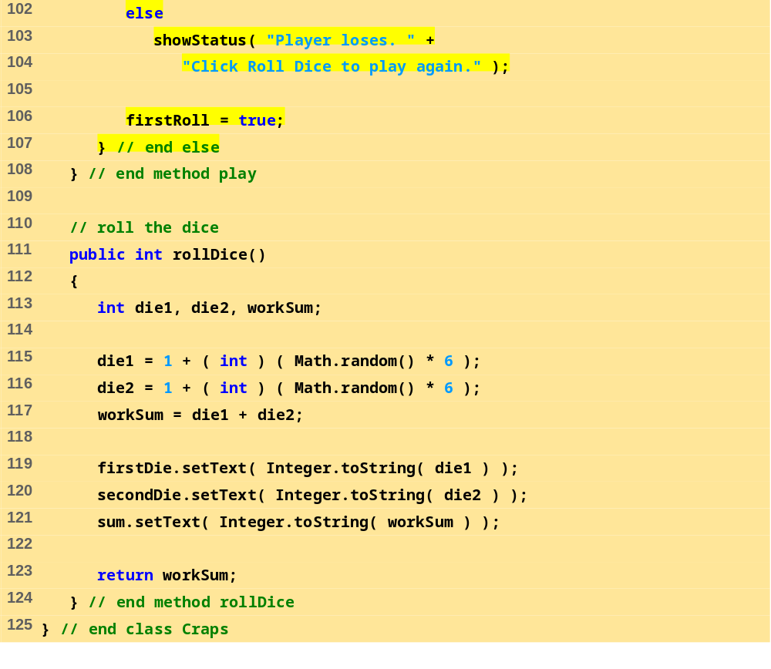
Craps.java (Pat 5 of 5)

Slide 44
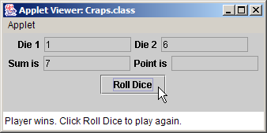
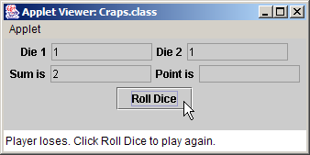
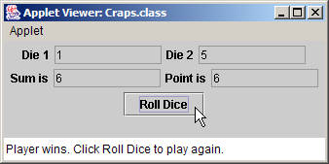
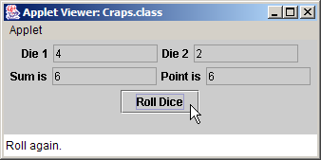
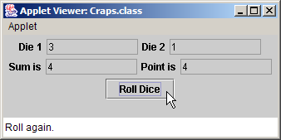
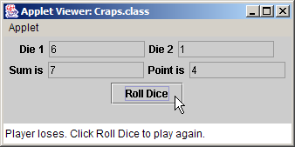
Program Output

Slide 45
25.8 Methods of Class JApplet
Methods of Class JApplet
  init, start, stop, paint, destroy
  Called automatically during execution
  By default, have empty bodies
  Must define yourself, using proper first line
    Otherwise, will not be called automatically
    See Figure 25.14 for proper first lines
Method repaint
  Dynamically change appearance of applet
  Cannot call paint (do not have a Graphics object)
  repaint(); calls update which passes Graphics object for us
    Erases previous drawings and calls paint

Slide 46
25.8 Methods of Class JApplet (II)
First line of JApplet methods (descriptions Fig. 25.14)
public void init()
public void start()
public void paint( Graphics g )
public void stop()
public void destroy()

Slide 47
25.9 Defining and Allocating Arrays
Arrays
  Specify type, use new operator
  Two steps:
    int c[]; //definition
    c = new int[ 12 ]; //initialization
  One step:
    int c[] = new int[12];
  Primitive elements initialized to zero or false
    Non-primitive references are null
  Multiple definitions:
  String b[] = new String[ 100 ], x[] = new String[ 27 ];
  Also:
  double[] array1, array2;
  Put brackets after data type

Slide 48
25.10 Examples Using Arrays
new
  Dynamically creates arrays
Method length
  Returns length of the array
  myArray.length
Initializer lists
  int myArray[] = { 1, 2, 3, 4, 5 };
    new operator not needed, provided automatically

Slide 49
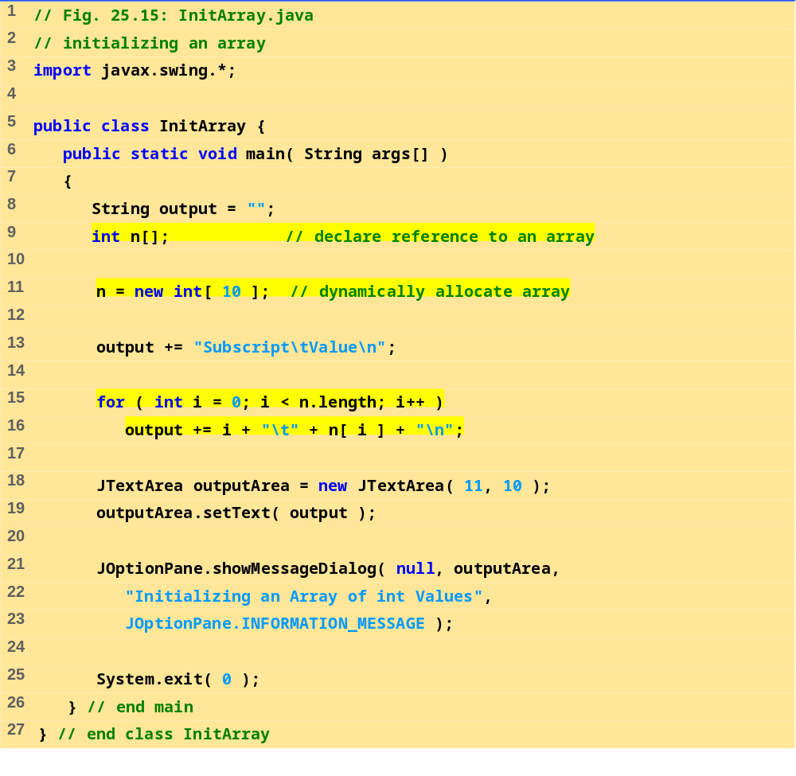
InitArray.java

Slide 50
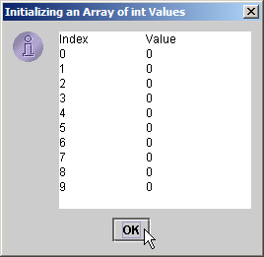
Program Output

Slide 51
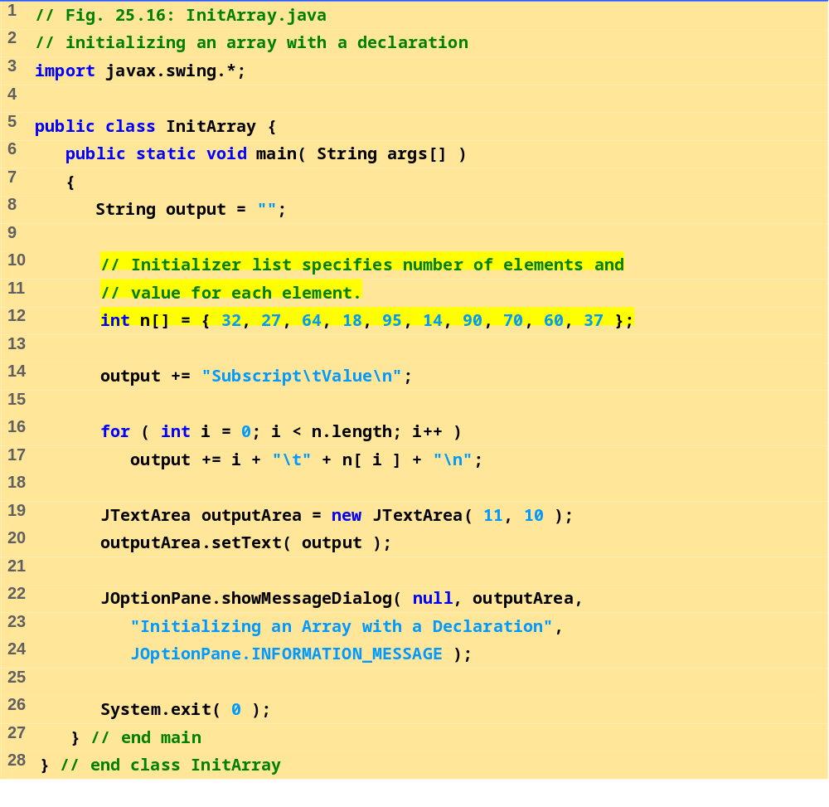
InitArray.java

Slide 52
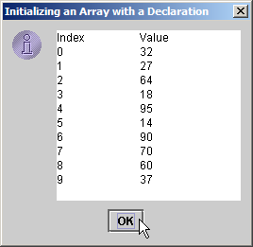
Program Output

Slide 53
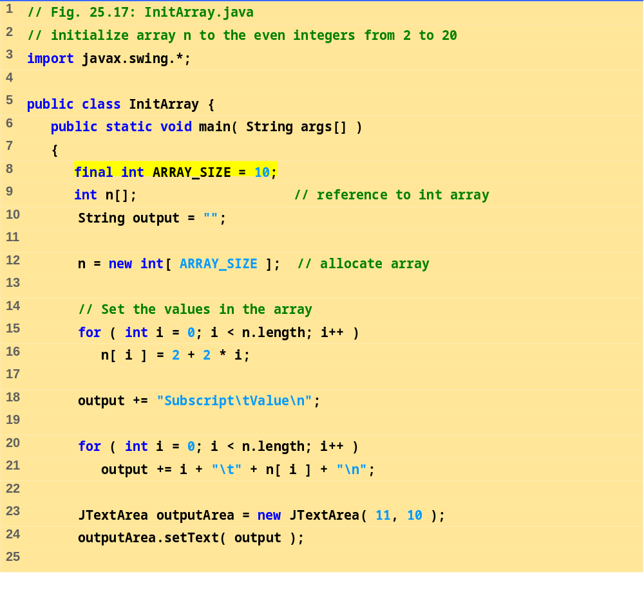
InitArray.java (Part 1 of 2)

Slide 54
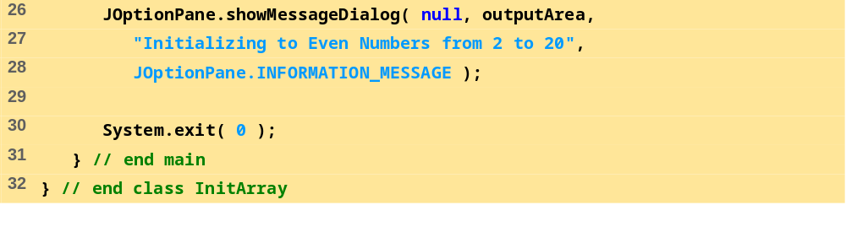
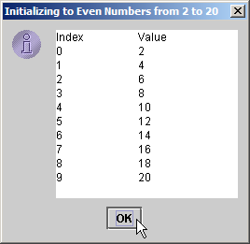
InitArray.java (Part 2 of 2)
Program Output

Slide 55
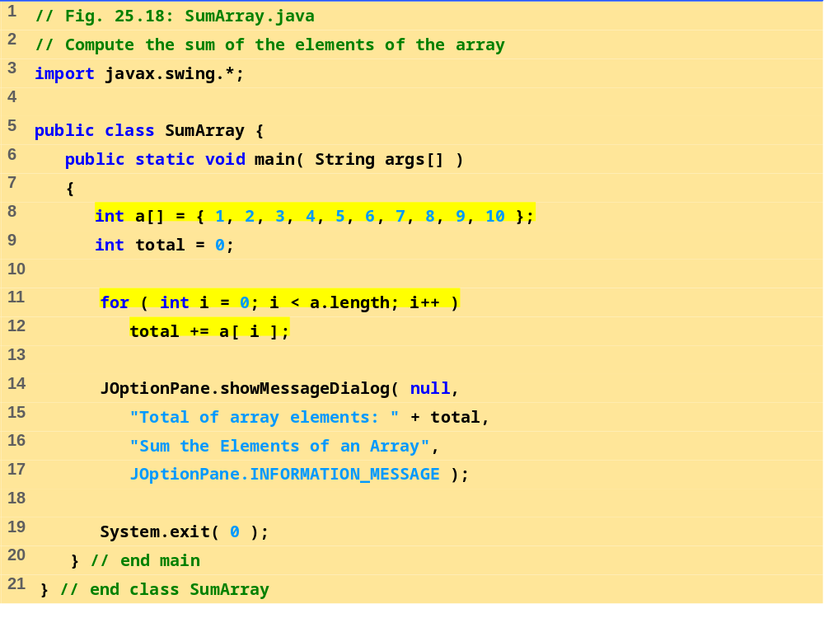
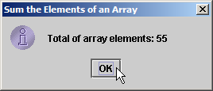
SumArray.java
Program Output

Slide 56
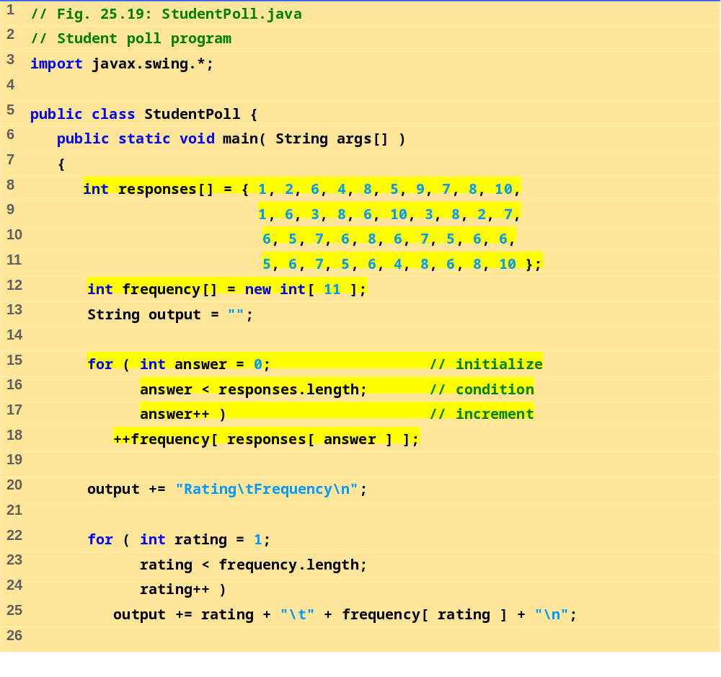
StudentPoll.java (Part 1 of 2)

Slide 57
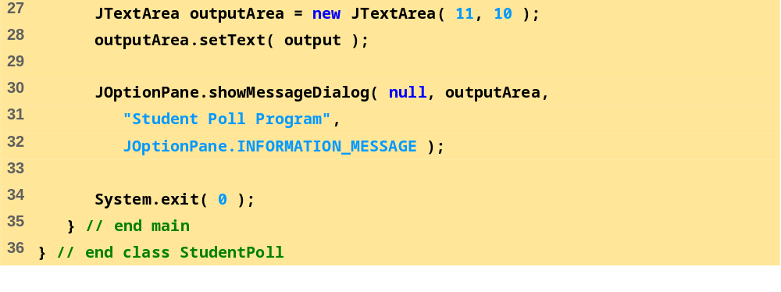
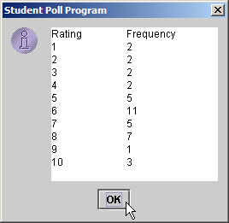
StudentPoll.java (Part 2 of 2)
Program Output

Slide 58
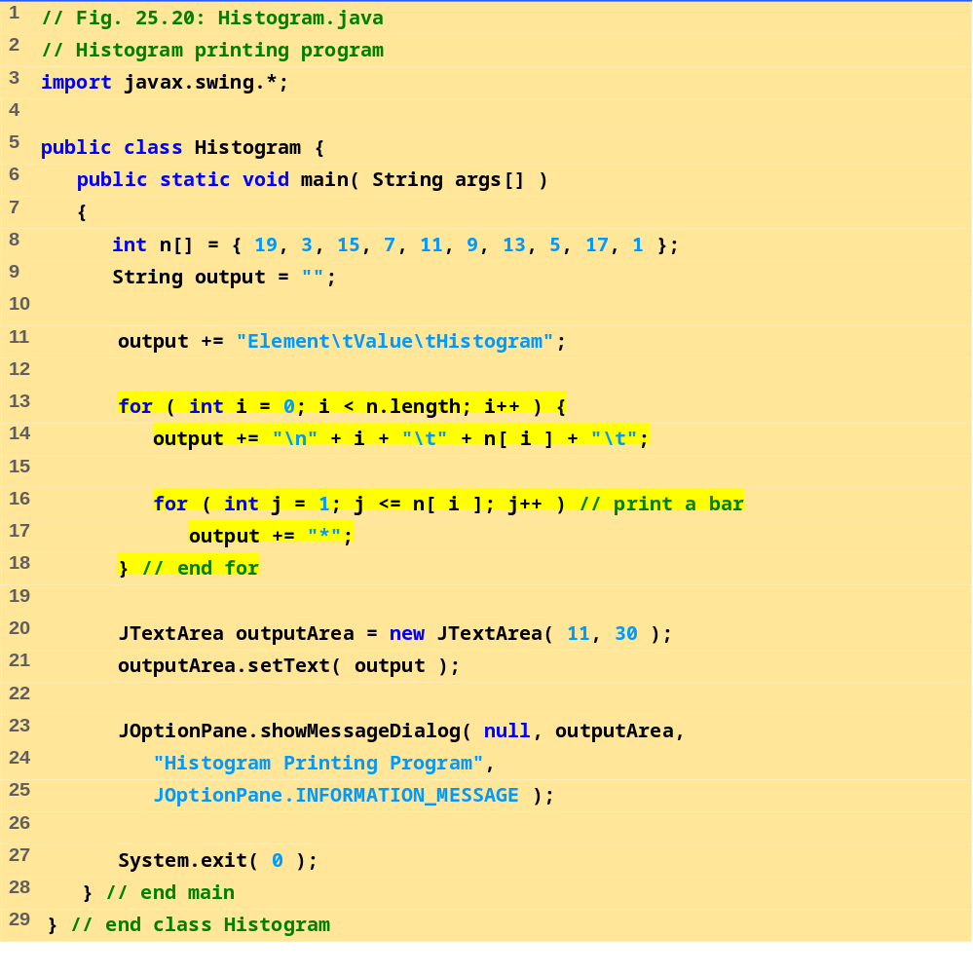
Histogram.java

Slide 59
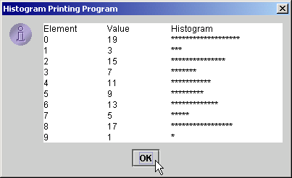
Program Output

Slide 60

RollDie.java (Part 1 of 2)

Slide 61


RollDie.java (Part 2 of 2)
Program Output

Slide 62
25.11 References and Reference Parameters
Passing arguments to methods
  Call-by-value: pass copy of argument
  Call-by-reference: pass original argument
    Improve performance, weaken security
In Java, cannot choose how to pass arguments
  Primitive data types passed call-by-value
  References to objects passed call-by-reference
    Original object can be changed in method
  Arrays in Java treated as objects
    Passed call-by-reference

Slide 63
25.12 Multiple-Subscripted Arrays
Multiple-Subscripted Arrays
  Represent tables
    Arranged by m rows and n columns (m by n array)
    Can have more than two subscripts
  Java does not support multiple subscripts directly
    Create an array with arrays as its elements
    Array of arrays
Definition
  Double brackets
  int b[][];
  b = new int[ 3 ][ 3 ];
    Defines a 3 by 3 array

Slide 64
25.12 Multiple-Subscripted Arrays (II)
Definition (continued)
  Initializer lists
    int b[][] = { { 1, 2 }, { 3, 4 } };
  Each row can have a different number of columns:
  int b[][];
  b = new int[ 2 ][ ]; // allocate rows
  b[ 0 ] = new int[ 5 ]; // allocate columns for row 0
  b[ 1 ] = new int[ 3 ]; // allocate columns for row 1
  Notice how b[ 0 ] is initialized as a new int array
1 | 2
3 | 4

Slide 65

InitArray.java (Part 1 of 2)

Slide 66


InitArray.java (Part 2 of 2)
Program Output

